Slide 1


Technical Report Presentation
Name: Ahmed Mohamed
ID:000397658

Slide 2
Content
Introduction
MS-Outlook
-Pros and Cons
Mozilla Thunderbird
- Pros and Cons
Conclusion

Slide 3
MS-Outlook
Under the Microsoft office Suit
Email client application
Customize its theme
To-do list and sharing calendar feature

Slide 4
Pros
Supports IMAP, Hotmail, MSN and POP
Spam filtering
Flexible Search
Conversations
Social networking updates

Slide 5
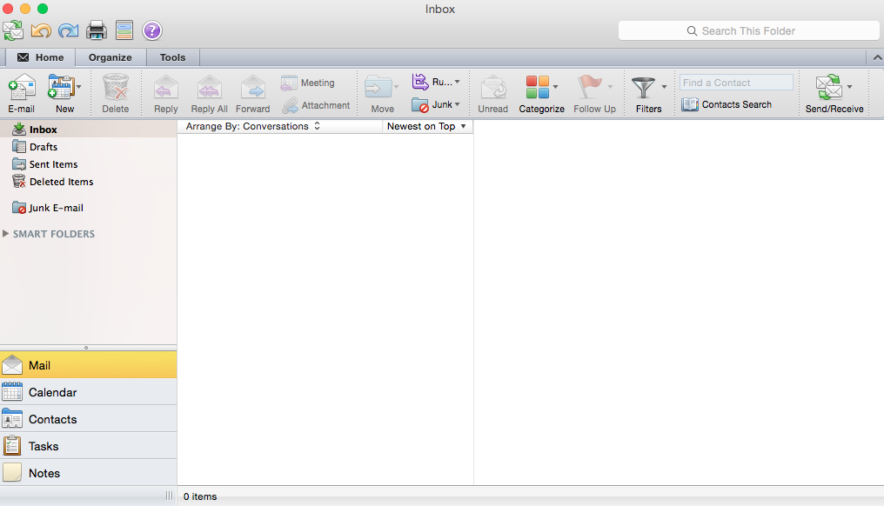

Slide 6
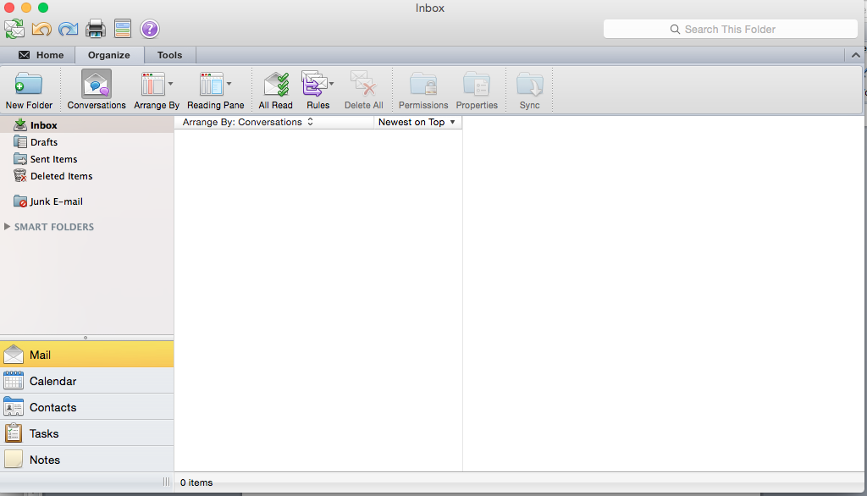

Slide 7
Cons
Setting up inflexibility
No full anti-spam security features
You got purchase the MS-Office suit

Slide 8
Mozilla Thunderbird
Open source application developed by the Mozilla community
Easiness of retrieving the user’s data through auto discovery
Easily customized theme

Slide 9
Pros
Supports POP, SMP, IMP, lDAP
Lots of them variety and extensions
Available on Windows and Mac
Bayesian filter
Smart folders
Firewalls, antivirus protection and spam filters

Slide 10
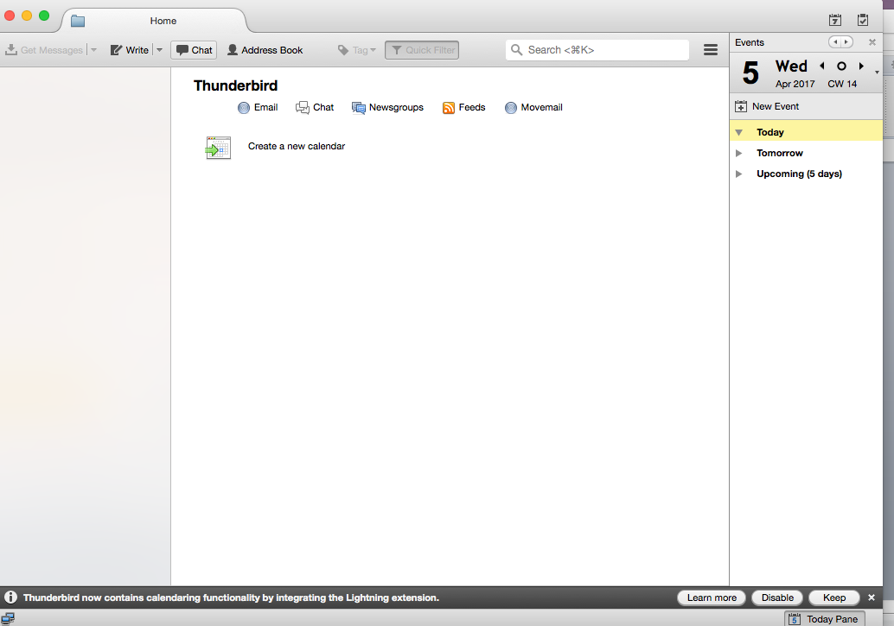

Slide 11
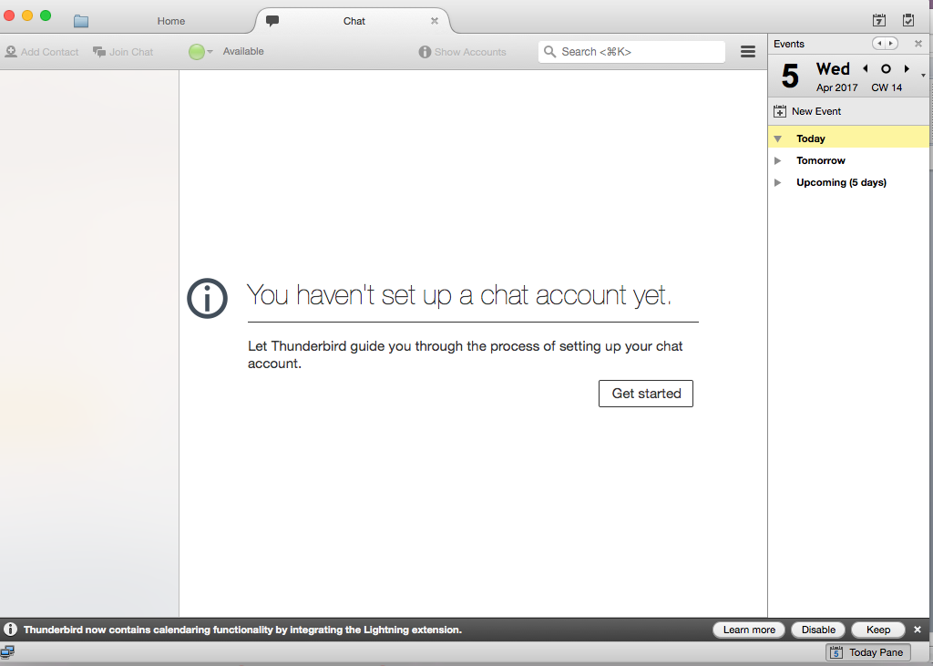

Slide 12
Cons
Doesn’t Show messages related together
Not easy to configure number of Security options
RSS feed could have been better synchronized than in the current version

Slide 13
Conclusion
-Mozilla Thunderbird is a better choice
-Security
-Open Source
-Features Variety

Slide 14
Thanks for listening ☺ Any Questions??

